Slide 1
Mahder Low Cost and Low Power Computer Platform

Slide 2
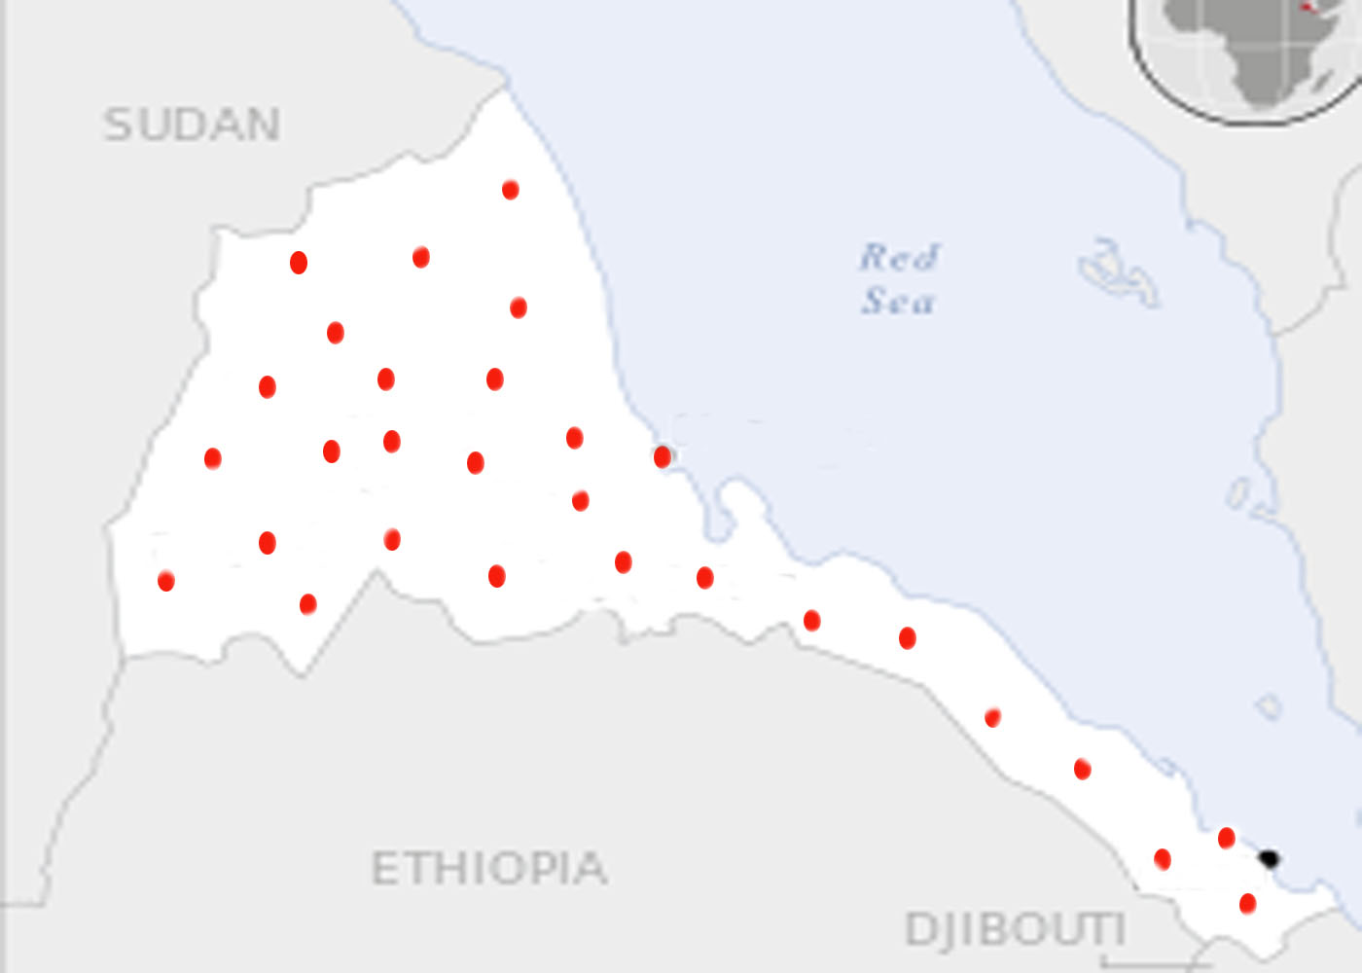
System coverage

Slide 3
Social Impact
Ensuring quality education because Students will be able to learn easily and efficiently.
Improve equality of Education by making resources more accessible, sustainable and affordable.
Esp. in remote areas where there is lack of teachers and learning resources, access to information for local communities becomes easy, thus it could be a game changer.
The teaching applications help learning in times where laboratories are not affordable.
This system is expected to make learning, computer aided training and teaching tens of times better.

Slide 4
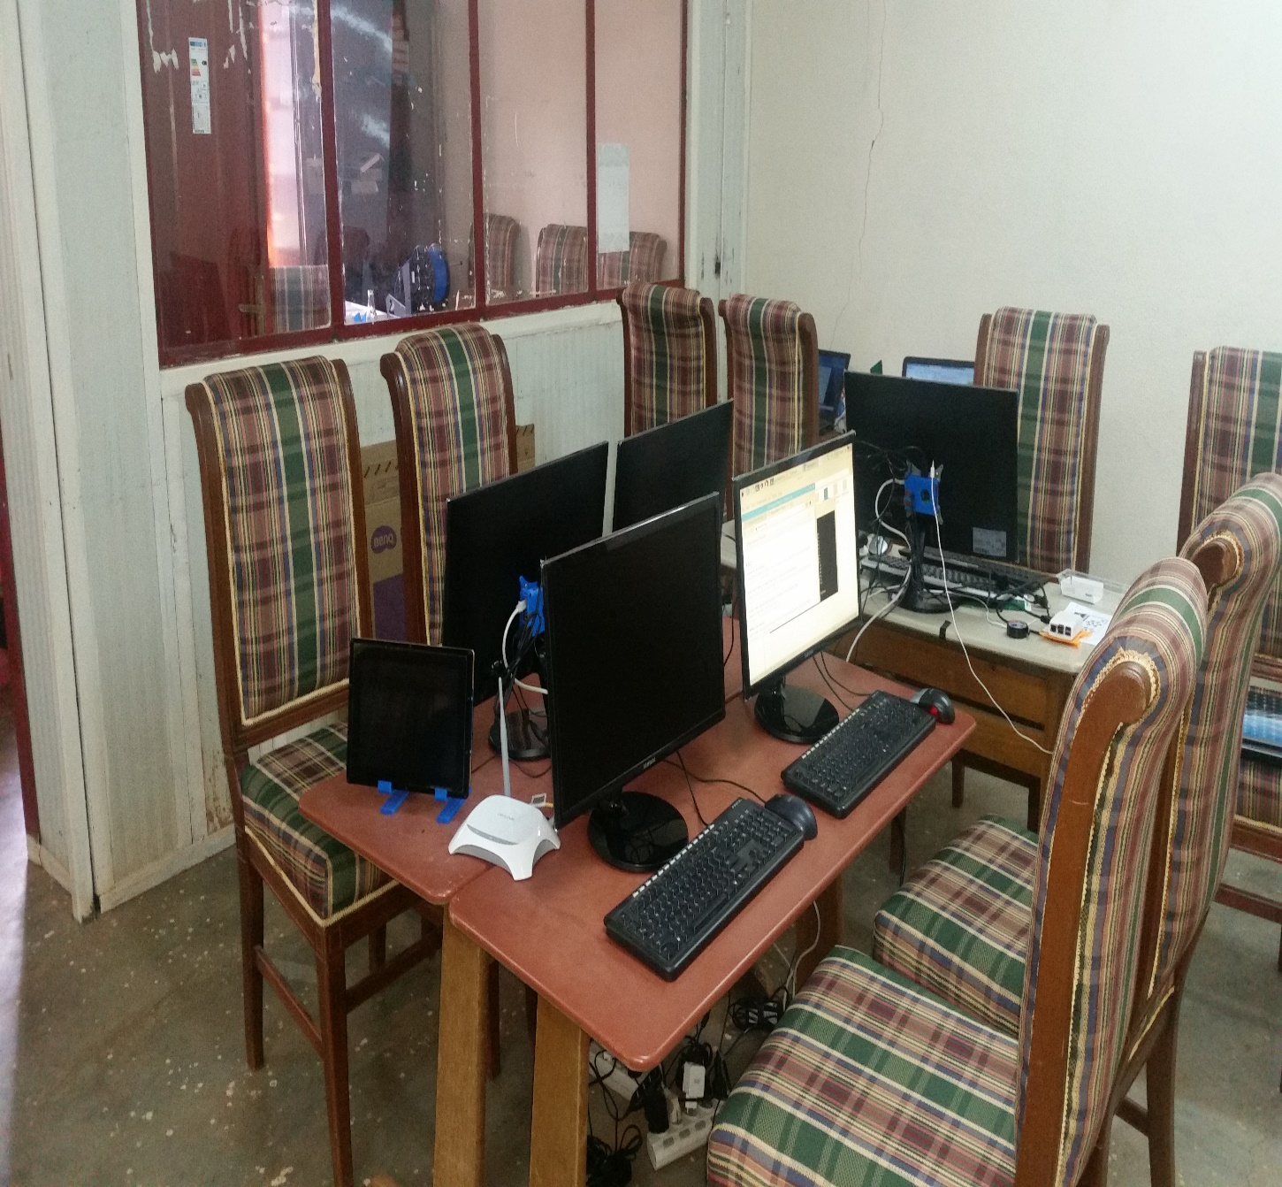
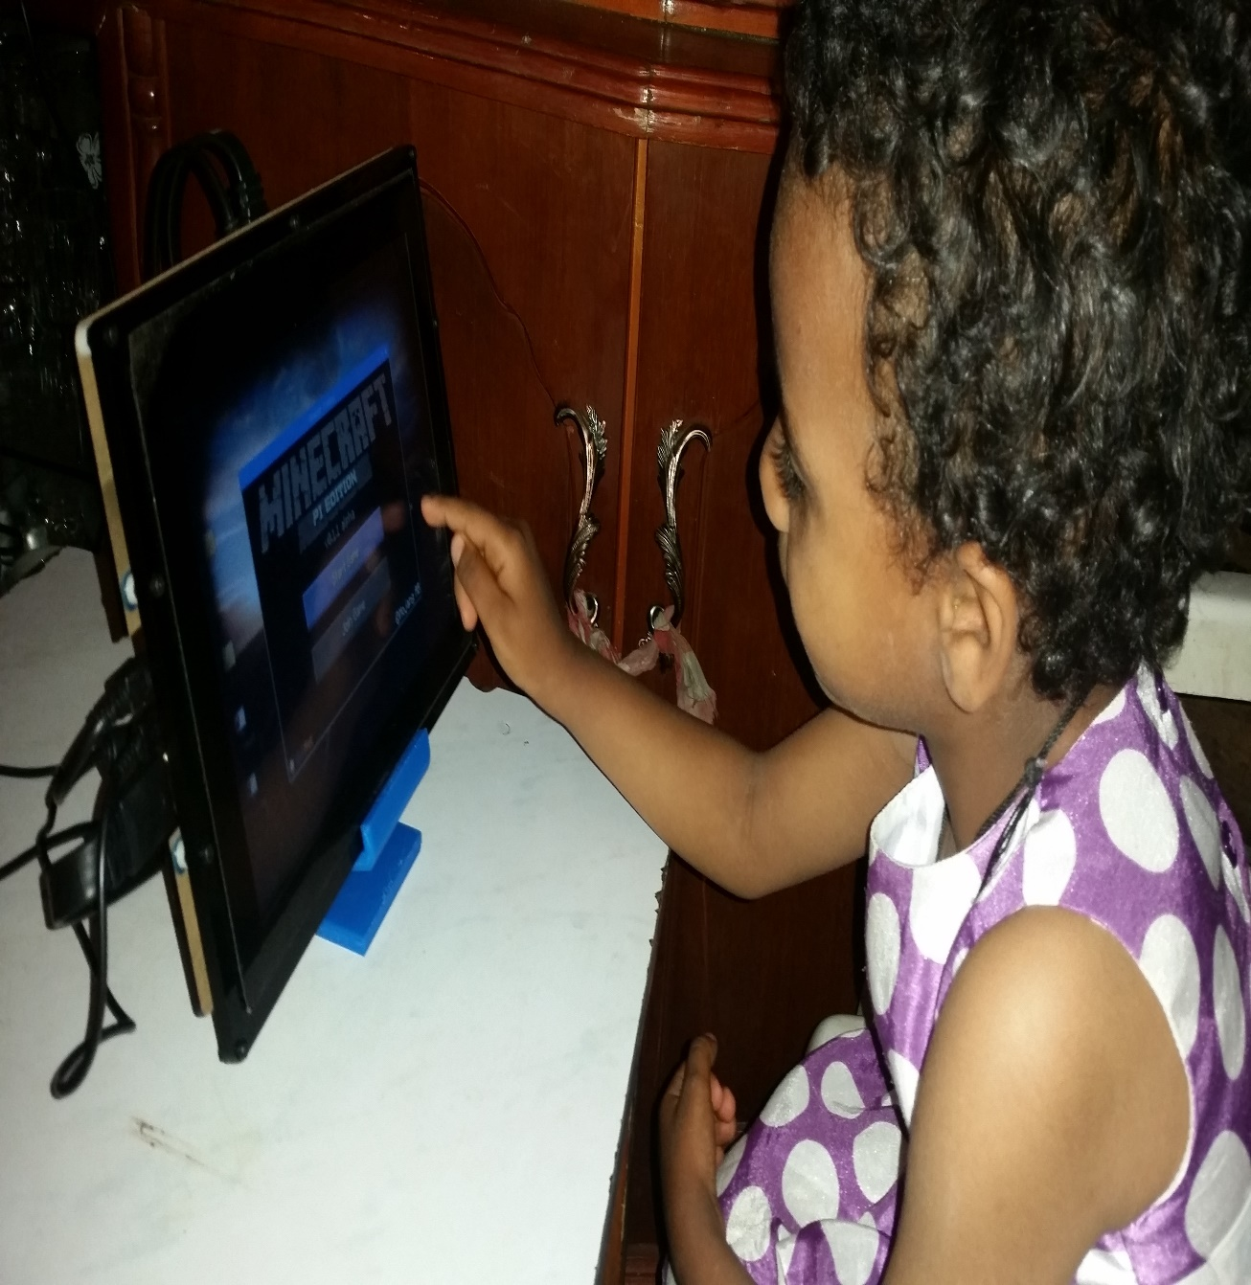

Slide 5
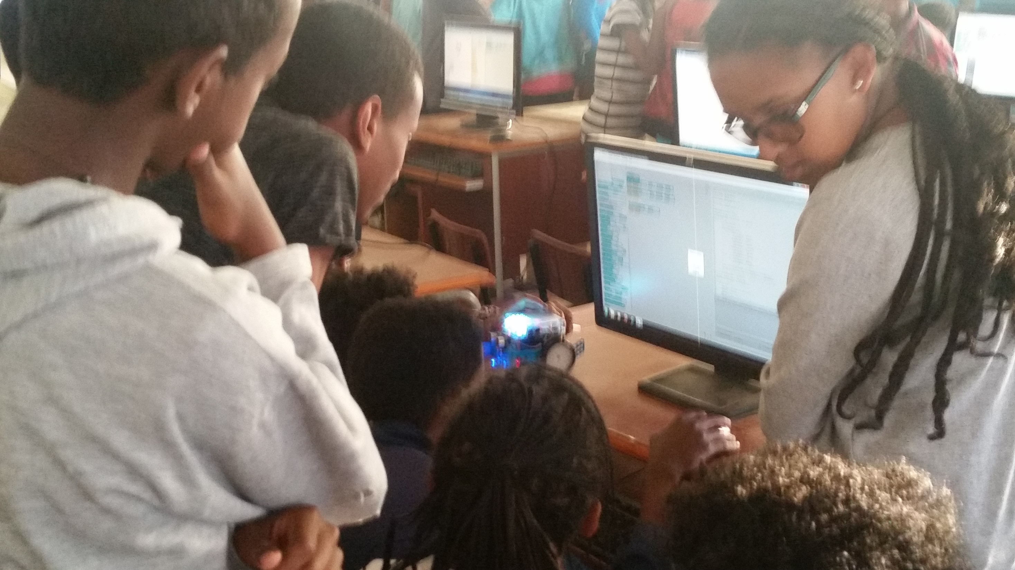
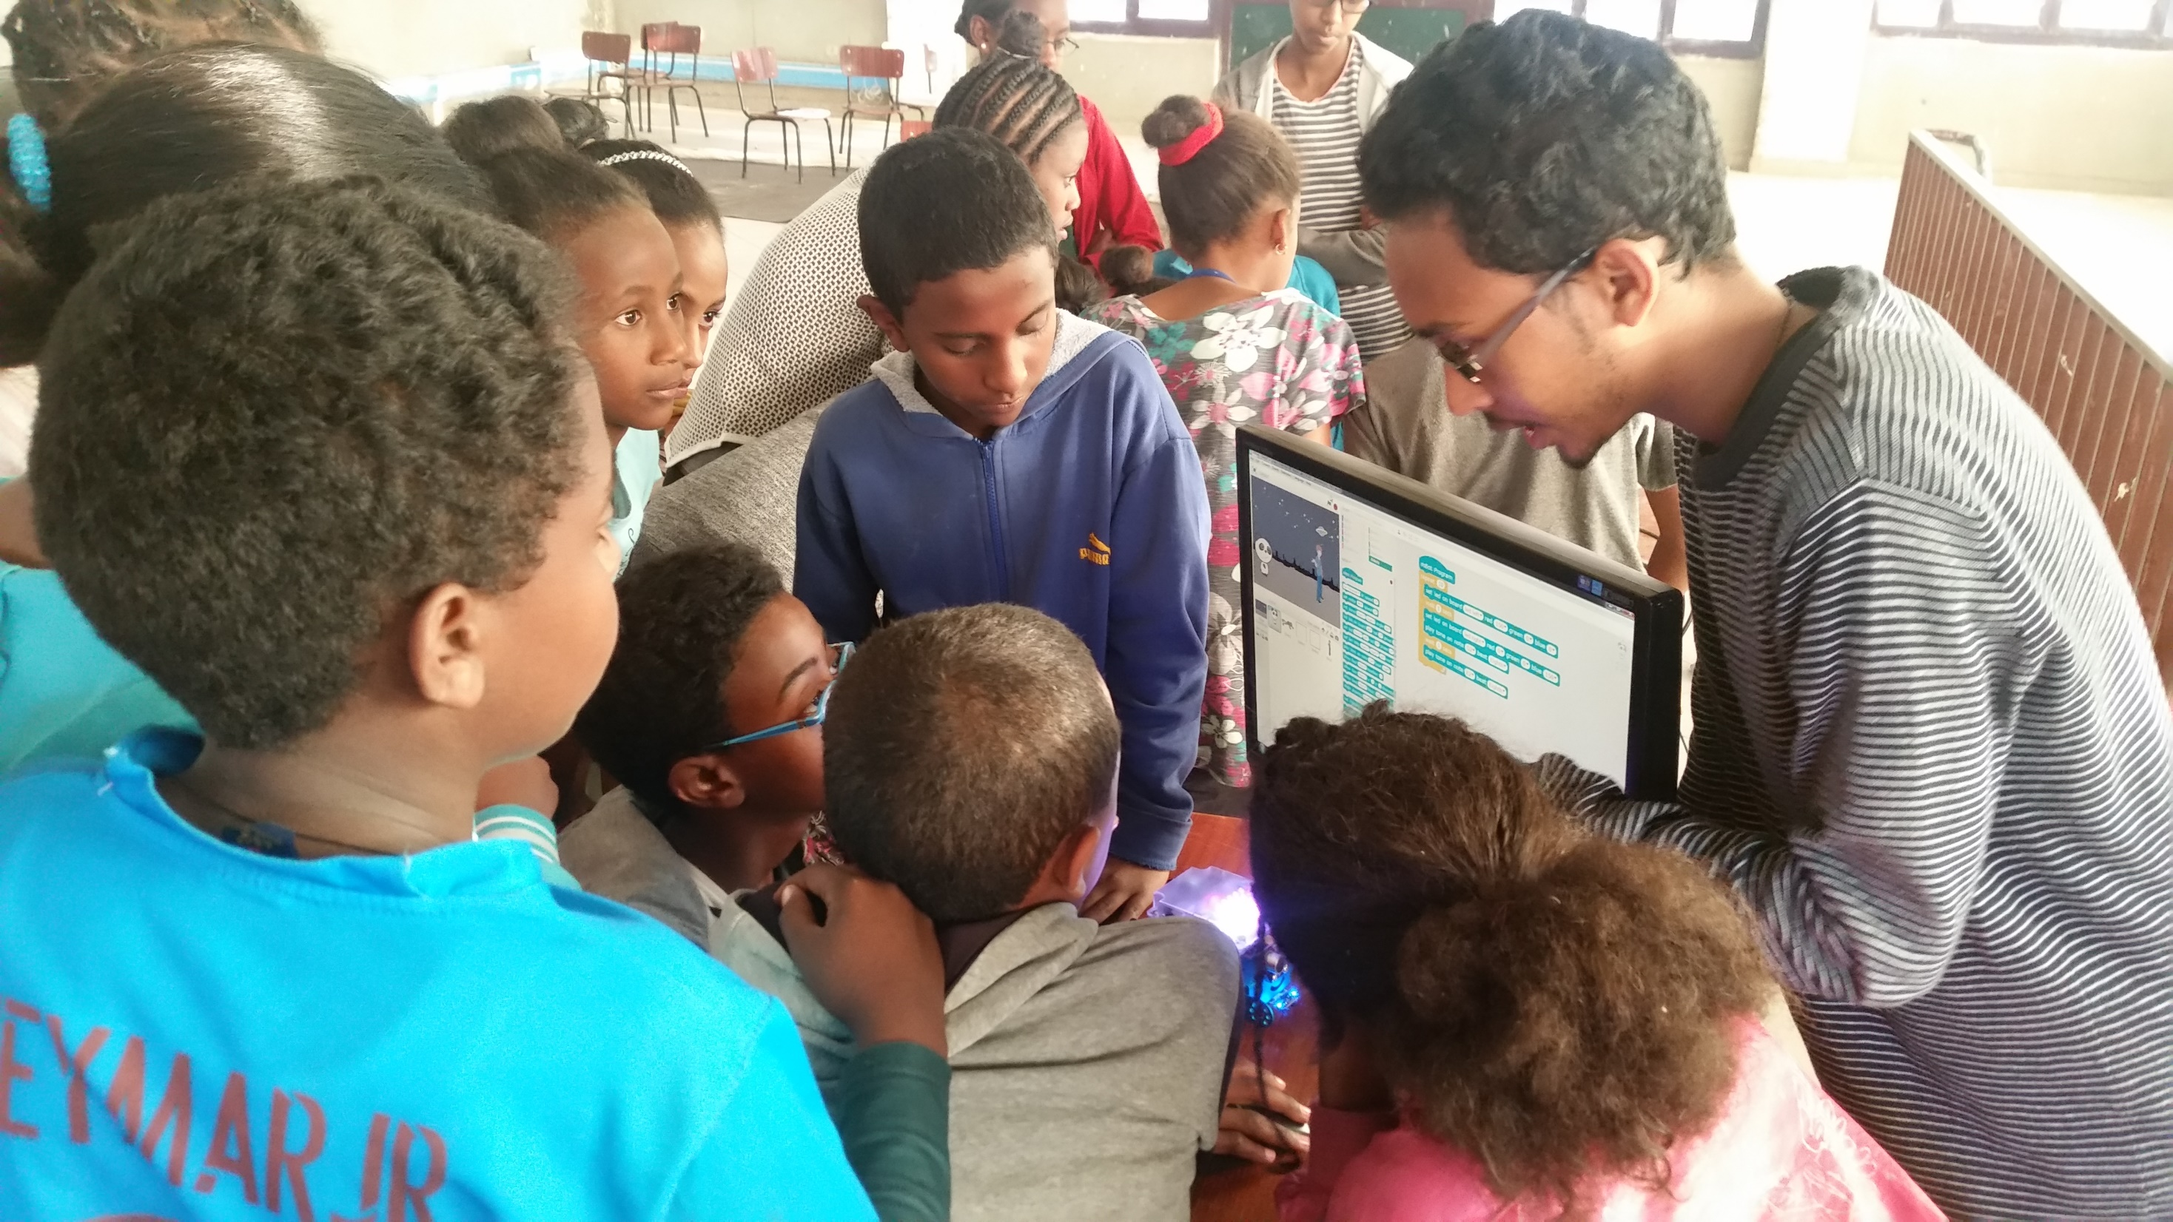
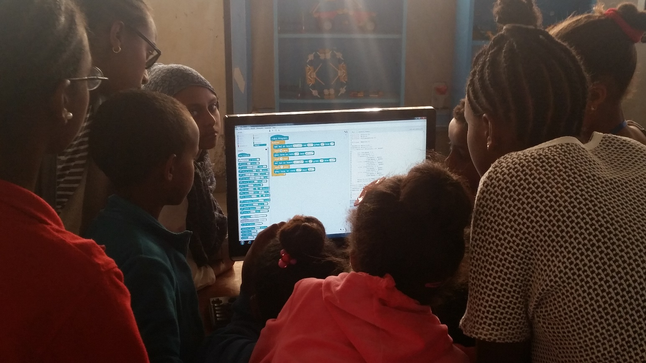

Slide 6
Economic Impact
Students and companies will benefit from the value of the system and lower price of buying and maintaining of the system.
Employees: It will create a great job opportunity for the population starting from manufacturing & assembly, training, programming to advanced researches.
Share holders and investors will benefit from the profit generated by the project.

Slide 7
Bussiness Model
The main business model used for this project is Razor Blade business model. Which strategizes to retain customers for long term by offering lower and reliable products.
Target customers:- are the Eritrean community: - mainly Students from age of 6 to 30, big institutions, companies, small business, schools in remote areas …etc
Sales and Marketing:-
we have associated with the ministry of education and other partners to reach different levels of students starting from kindergarten to colleges.
Separate sales model: Search Engine, Digital library, training systems, solar systems, networking and other applications (games for teaching, educational software … etc.).

Slide 8
Bussiness Plan
Company Profile :- Mahder Computer and Information Systems
Main Bussiness:- Computer and Computing services provision
Current Status:- Pilot project is in progress.
The Mission:- of our project is to make products that are low cost, low power consuming and reliable computing products and services with huge repository.
Vision of the company:- is to make our product to be used in every home as personal accessory and in every school as learning and digital laboratory computers.
In 2019 the company is planning to sell around 8,000 systems in the whole of Eritrea. This will make the company to financially sustain itself and continue to improve its profits.

Slide 9
Business Plan Cont..
Sources of Cash: Sales and Equity Investments.
Market penetration and Customer Retention
Lowering Prices
Freemium and premium services
partnership
Pricing and Profitability The portable computer has a price range of from 1,200 Nakfa to 2,500 Nkf. The advanced customers which also buy advanced services like search engine or other services will be paying from 50,000 Nkf to 250,000 Nkf.

Slide 10
Current Demands
Ministry of Education, ICT Center
Schools (From Elementary school to Colleges).
Government Organizations
Eritrea Institute Technology
Other companies

Slide 11
Partners
University of Eastern Finland (UEF)
Eritrea Institute of technology
Ministry of education
Expo Kids and Innovation Center
Other Colleges and Schools

Slide 12
 | Existing System | New System
Power | 120 to 150 watt per PC | 15 – 20 watt per PC
Price | 7,000 to 15,000 Nkf per PC | 1,200 to 1,500 Nkf per PC
Repository | Nothing | Huge repository(3 to 6 TB) of data reposity
Lab Deployment | Days | Less than one hour
Maintainability | Expensive and hard | Cheap and easy
Design | Generic | Educational Friendly
Languages Supported | Low support for languages | Local languages supported(5)

Slide 13
Thank You

